Slide 1

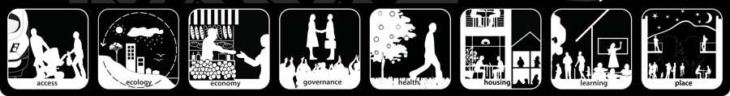
Lesson 1

Slide 2




Slide 3
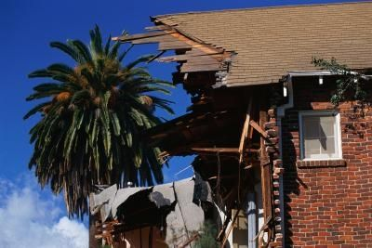
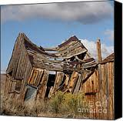
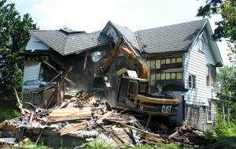
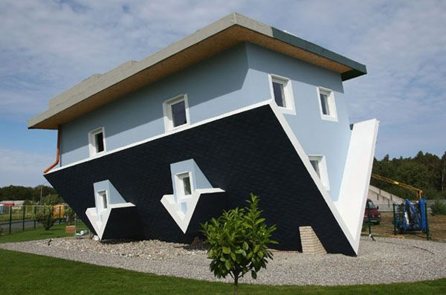

Slide 4
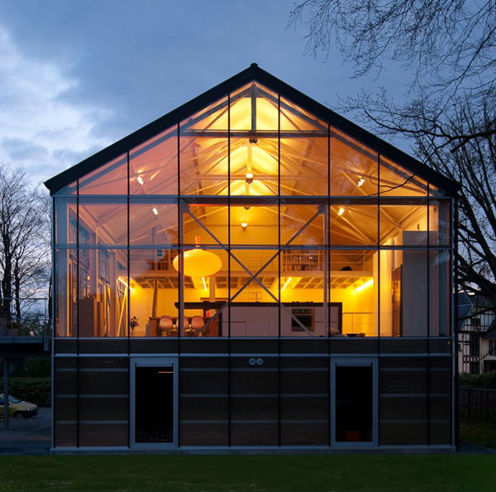
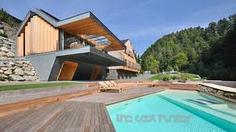

Slide 5

'Liveability' - the qualities of a place (city, town, suburb, neighbourhood) that contribute to the quality of life experienced by residents and others.

Slide 6
‘Liveability’ –
suburbs/neighbourhoods
The liveability of suburbs and neighbourhoods depends on the environmental and social quality of a place as perceived by residents, workers, customers and visitors to the area.
These factors include:

Slide 7
Environmental
Social
Cultural
Infrastructure
Economic

Slide 8
Environmental
Social
Cultural
Infrastructure
Cleanliness, dust, pollution, noise, air and water quality, aesthetics
personal security, traffic safety, community identity and pride, neighbourliness
historic structures, mature trees, traditional architectural styles, streetscapes
streets, public transport, health, shopping centres, schools, religious institutions, parks and sporting facilities, other public facilities.
Economic
Value of property

Slide 9




How ‘liveable’ is Narrogin?

Slide 10



Put your group findings in a chart:

Slide 11
How ‘liveable’ is Narrogin?
Environmental
Social
Cultural
Infrastructure
Cleanliness, dust, pollution, noise, air and water quality, aesthetics
personal security, traffic safety, community identity and pride, neighbourliness
historic structures, mature trees, traditional architectural styles, streetscapes
streets, public transport, health, shopping centres, schools, religious institutions, parks and sporting facilities, other public facilities.
Economic
Value of property

Slide 12

How ‘liveable’ is Narrogin?

